Slide 1

Introduction

Slide 2

The Ethical Computer Professional

Slide 3
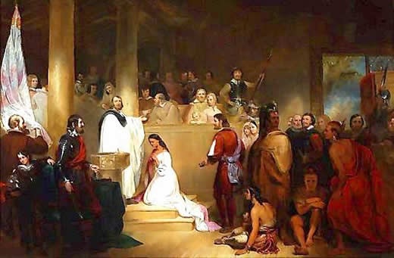
Who is this person and why should we care?
John Rolfe (1585–1622)
Notes:
https://www.aoc.gov/art/historic-rotunda-paintings/baptism-Pocahontas
John Rolfe (c. 1585 – 1622)
Rolfe developed new technology – a strain of tobacco that grew well in VA and that Europeans wanted. It kept the VA colony alive. But what were some unintended consequences? (tobacco deaths today, slavery back then) Do we need to worry about unintended consequences of today’s technologies?

Slide 4
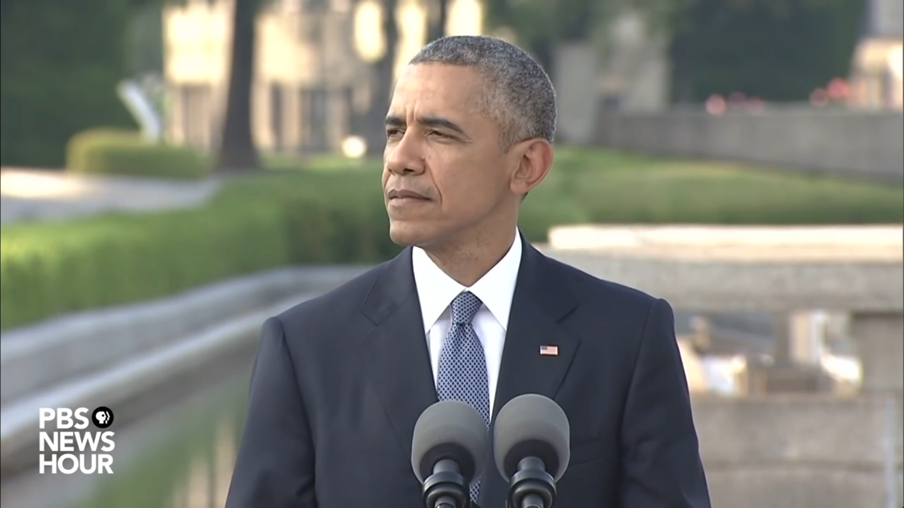
President Obama at Hiroshima
"Technological progress without an equivalent progress in human institutions can doom us. The scientific revolution that led to the splitting of an atom requires a moral revolution as well. That is why we come to this place."
Notes:
http://www.latimes.com/world/la-fg-obama-hiroshima-20160527-snap-story.html

